Slide 1
Matrix Decompositions: QR & SVD Applied to Image Processing With Python By John Stulich Research Supervisor: Dr. Debananda Chakraborty New Jersey City University, 2019

Slide 2
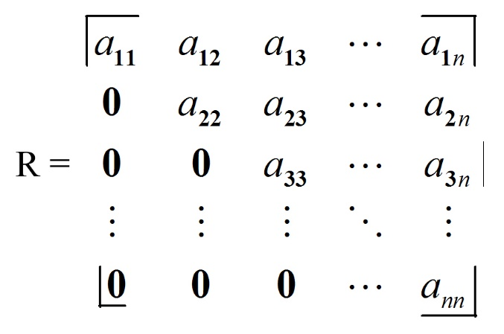
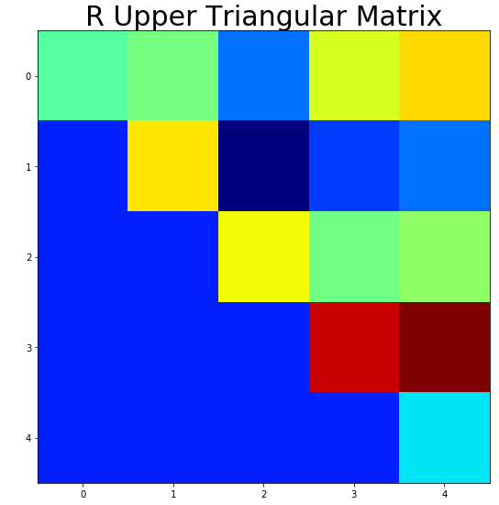
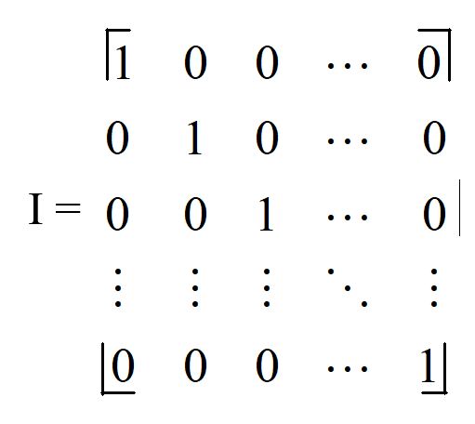
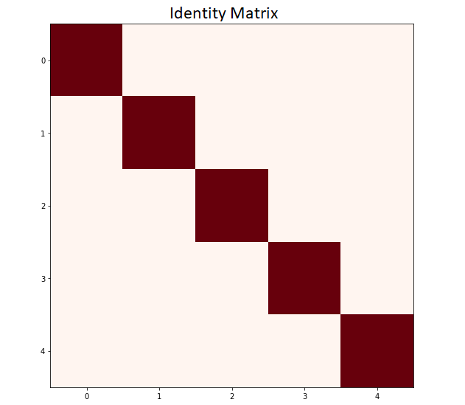
Matrix Decompositions
A = QR R = Q^{T}A A = QR
Transpose: interchange the rows and columns of a matrix or array
A_Transpose = A.T or B = np.transpose(A)
A = Image Matrix Q = Orthogonal Matrix --> Q^{T}Q ⁼ I (Identity Matrix)
R = Upper Triangular Matrix R = np.triu(A) or R1 = np.triu(A,0) # 0 is the index
D = Diagonal Matrix D = np.diag(A)
Upper Triangular Matrix
Identity Matrix

Slide 3
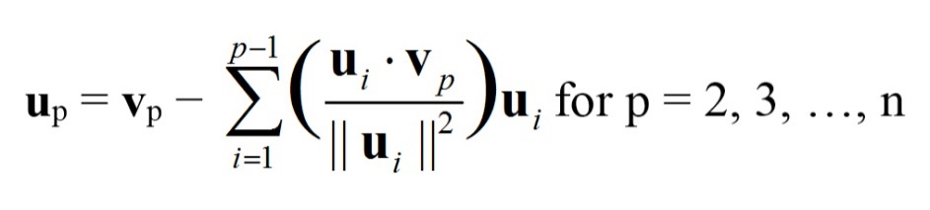
Gram–Schmidt General Formula
Converts non-orthgonal matrix into an orthogonal matrix
“Distills” non-”cost-efficient” matrix into a “cost-efficient” matrix
“Cost-efficient” = computationally efficient

Slide 4
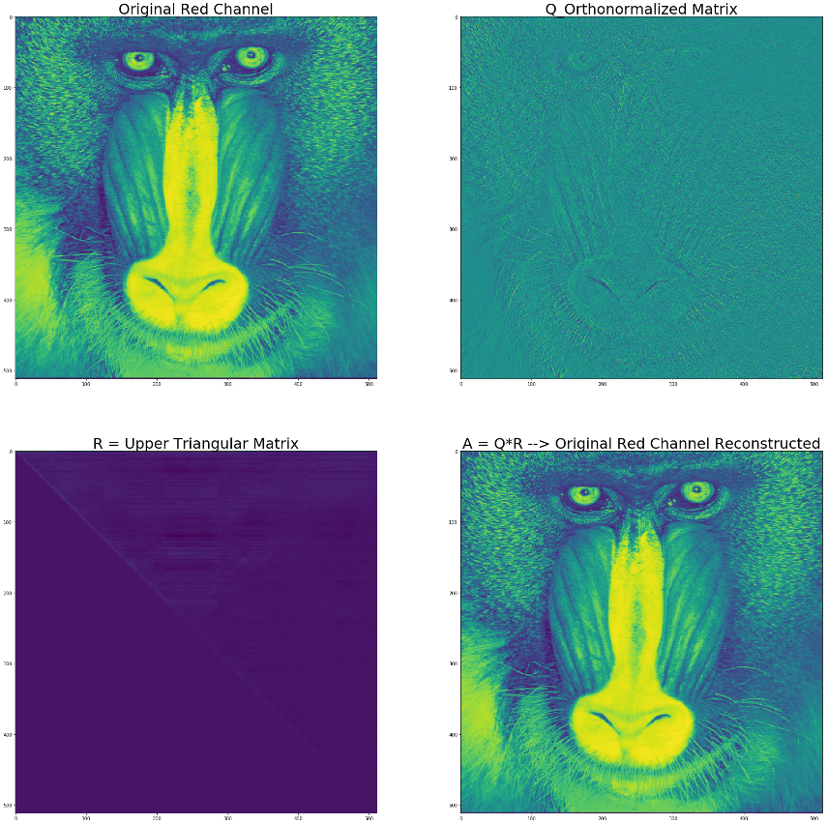
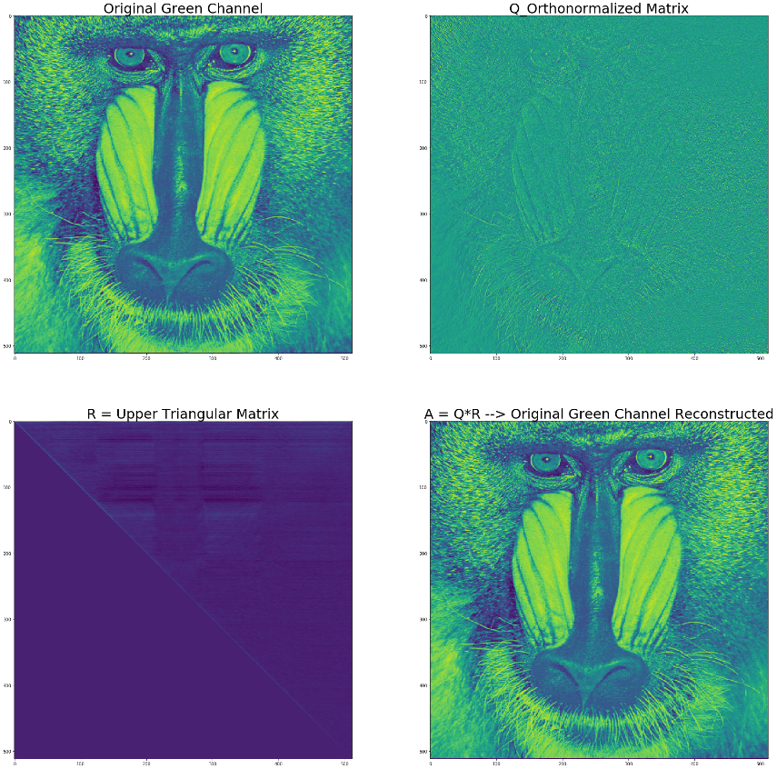
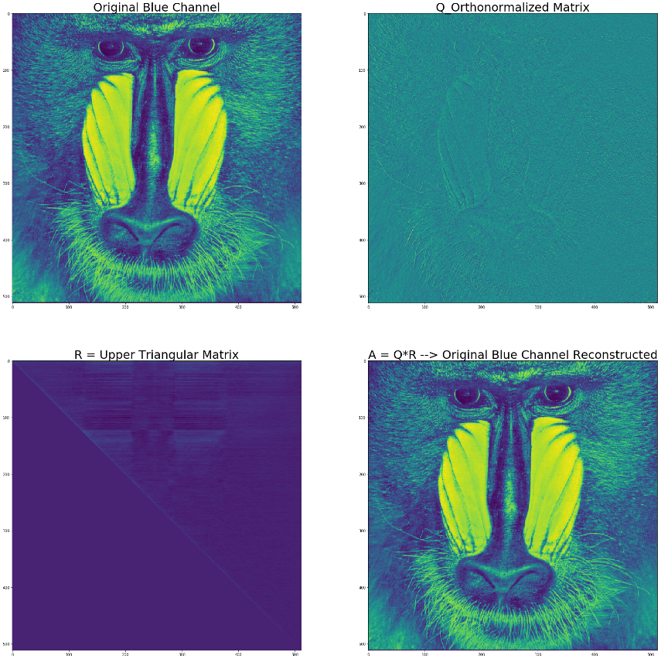
Gram–Schmidt Process – Python Output
Image Decomposition: A = QR & R = Q^{T}A
Red Channel Green Channel Blue Channel

Slide 5
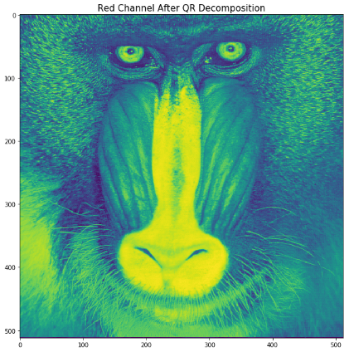
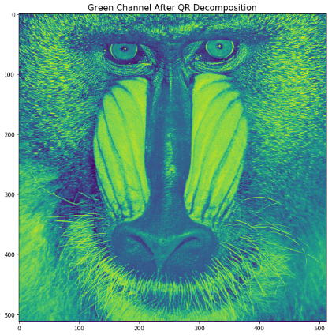
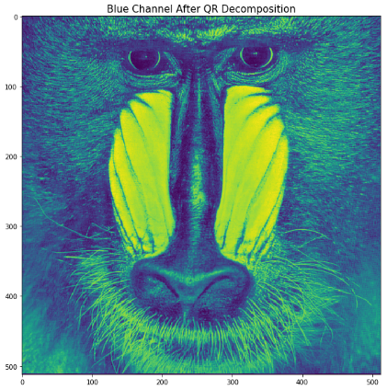
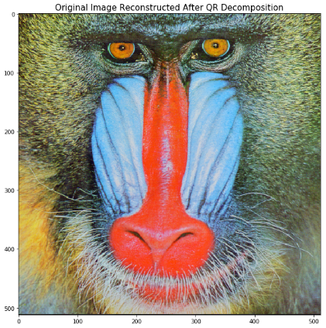
Gram–Schmidt Process – Python Output
Image Reconstruction – 3 Channels Combined to Reconstruct Original Image

Slide 6
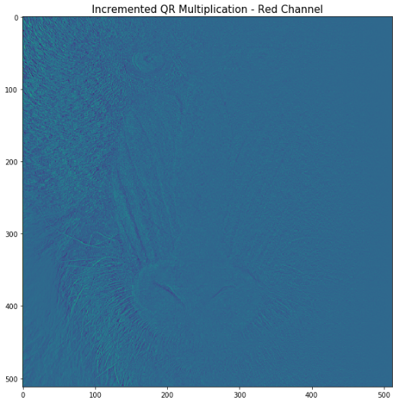
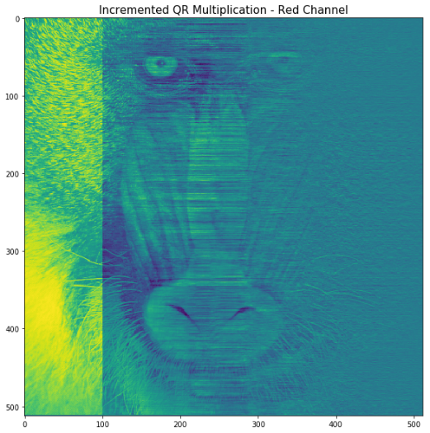
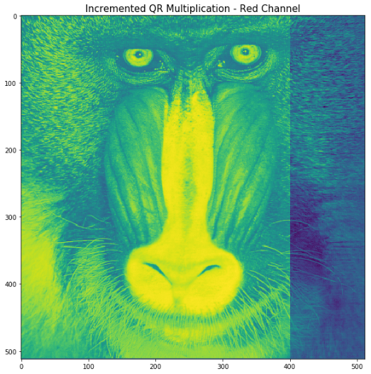
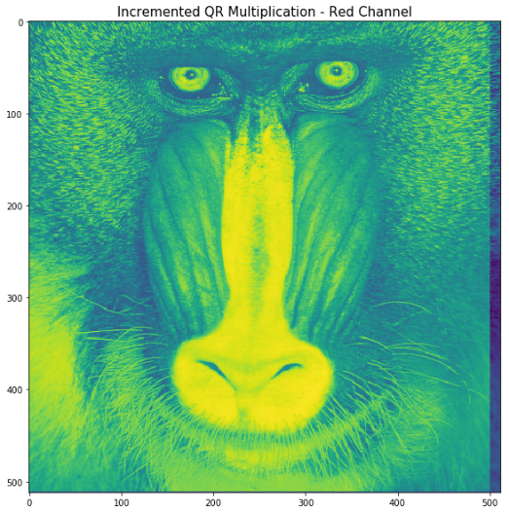
Gram–Schmidt Process – Python Output
Image Reconstruction Through Incremental
A = QR Multiplication – One Channel
A = QR R = Q^{T}A A = QR
Original channel incrementally reconstructed after successive QR multiplication, (501 iterations), reconstructing approximately, 97.8515625 % per color channel of each original channel.

Slide 7
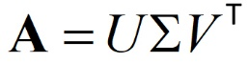

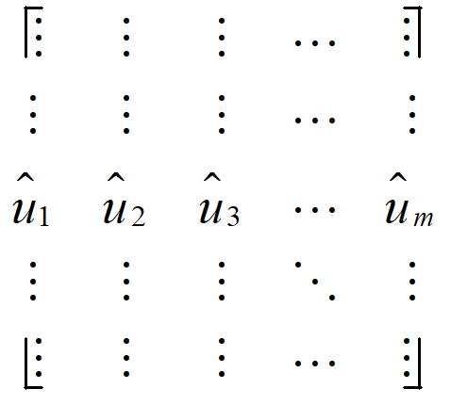
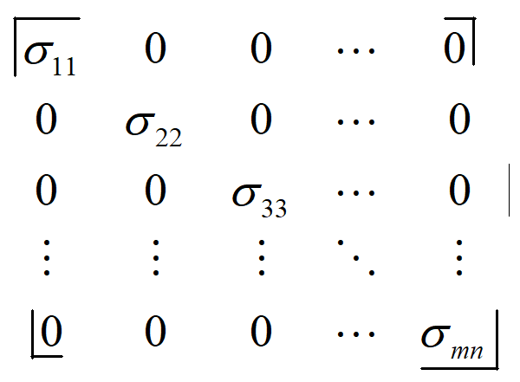
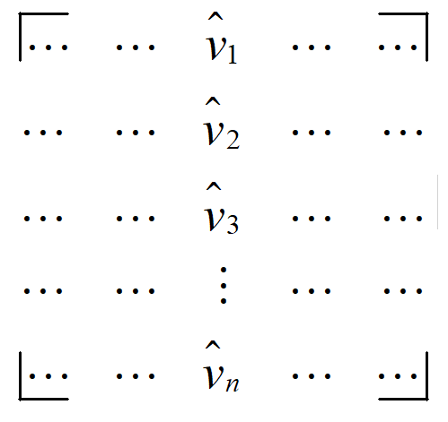
SVD – Singular Value Decomposition
A = Original Matrix ∑ = diagonal matrix (square root of eigenvalues of AA^{T} & A^{T}A)
U = Eigenvectors of AA^{T} (Left singular vectors) V = Eigenvectors of A^{T}A (Right singular vectors)
U^{T} U = I (Identity Matrix) V^{T} V = I (Identity Matrix)
U, Sig, V = np.linalg.svd(A) A_Recon = np.linalg.multi_dot([U,np.diag(Sig),V])
Eigenvectors and eigenvalues store key information / key features of a matrix; and help in time travel
Source: www.inverse.com
U _{m x m}
∑ _{m x n}
V^{T} _{n x n}

Slide 8
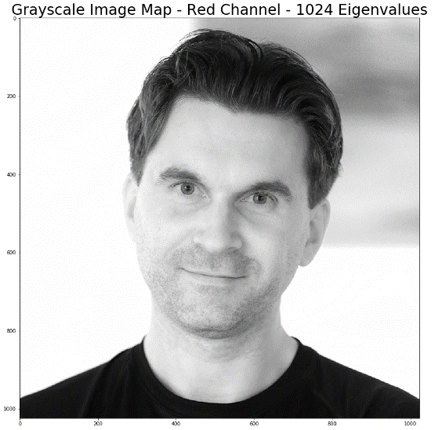
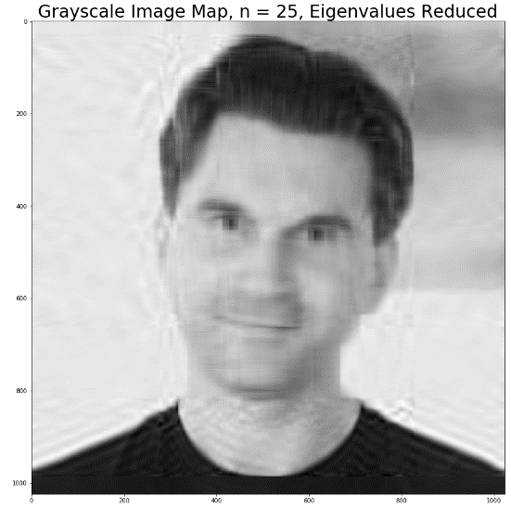
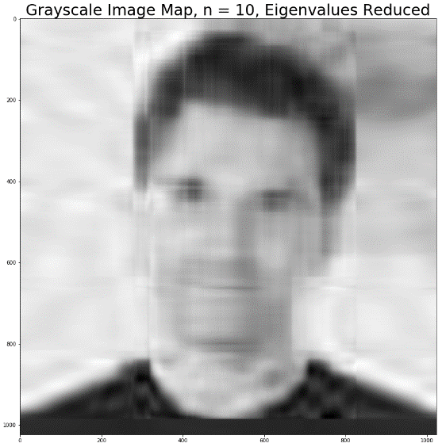
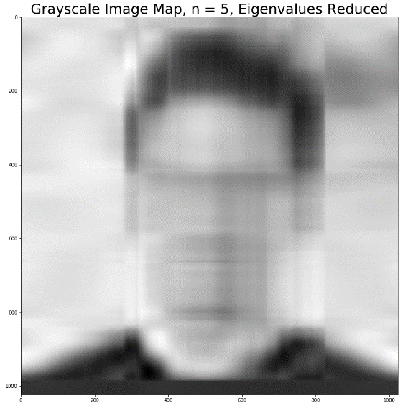
Applications of SVD – Eigenvalue Reduction
Eigenvectors U and V^{T} remain unchanged, while eigenvalues ∑ are reduced
Key facial features (principal components) are still recognizable
1024
Eigenvalues
25
Eigenvalues
10
Eigenvalues
5
Eigenvalues

Slide 9
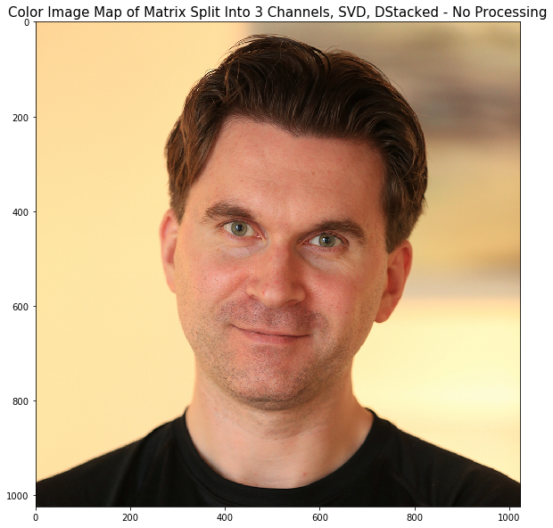
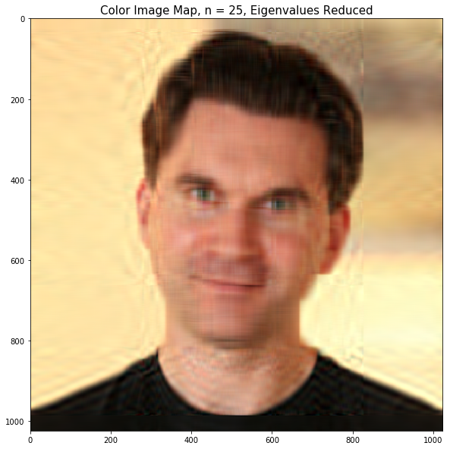

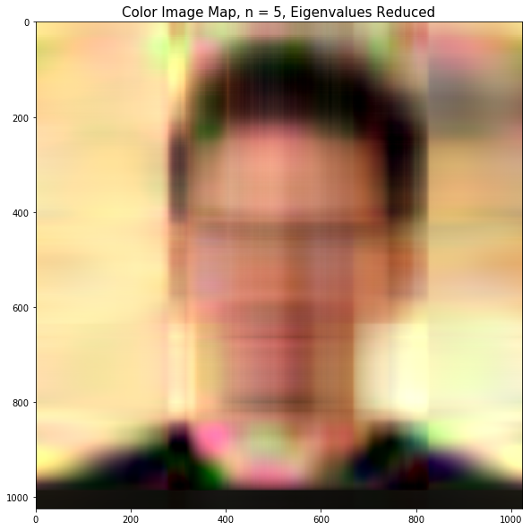
Applications of SVD – Eigenvalue Reduction
Eigenvectors U and V^{T} remain unchanged, while eigenvalues ∑ are reduced
Key facial features (principal components) are still recognizable
SVD performed per channel - RGB
1024
Eigenvalues
25
Eigenvalues
10
Eigenvalues
5
Eigenvalues

Slide 10
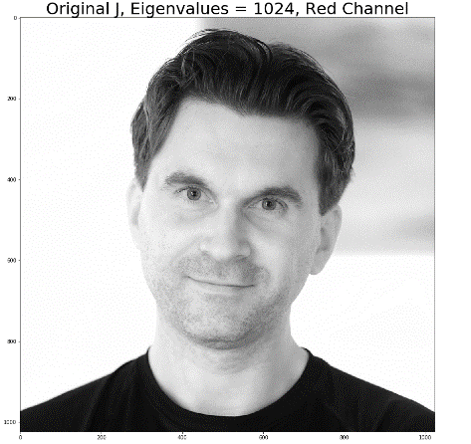
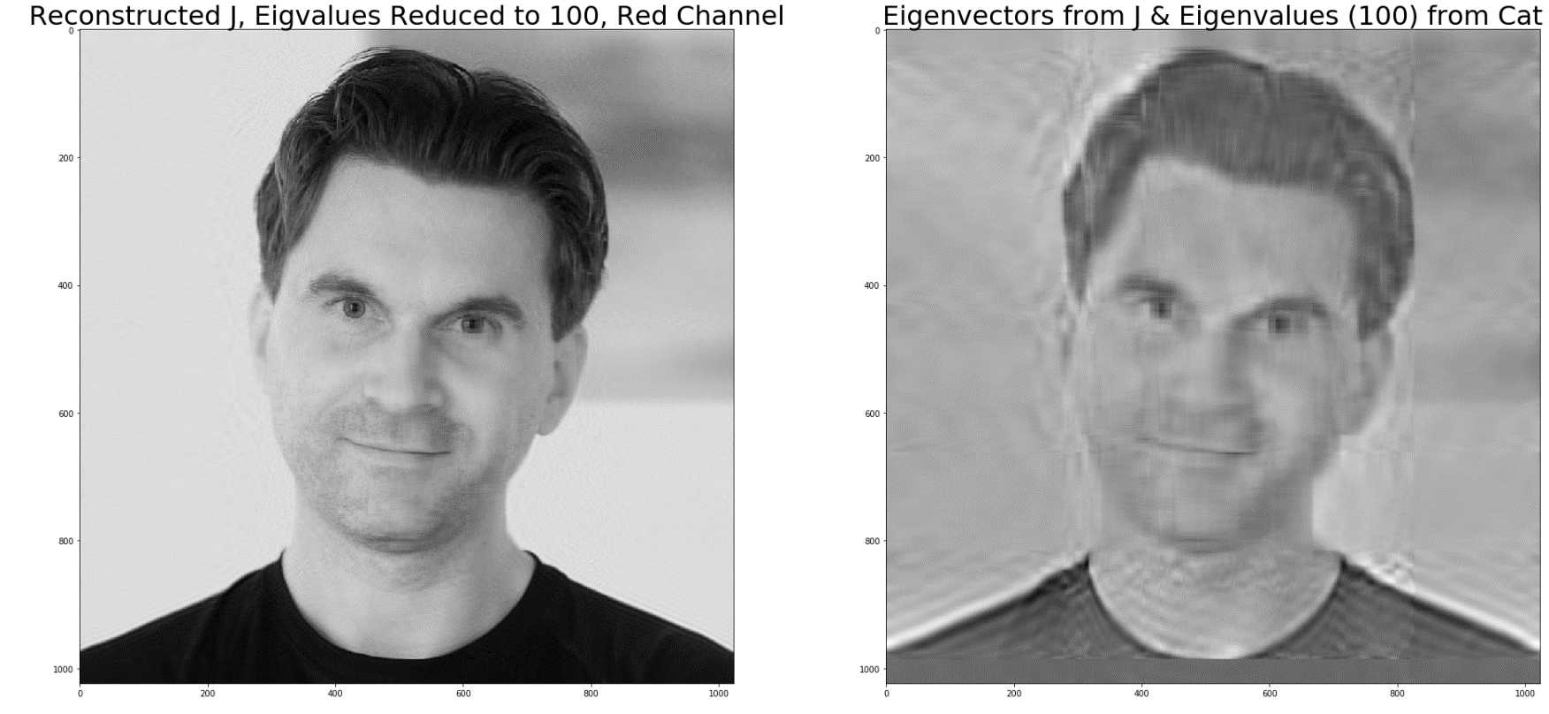
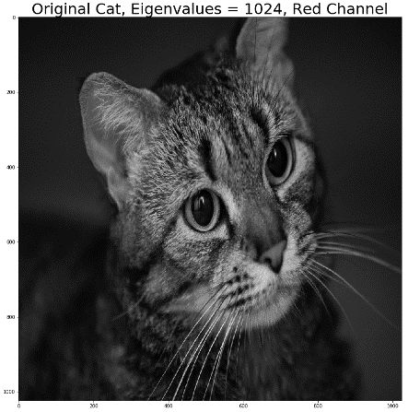
SVD – Mixing Eigenvectors and Eigenvalues
Eigenvectors from J and Eigenvalues (reduced to 100) from Cat
Recombined through SVD = U ∑ V^{T}
Eigenvalues are affecting the luminance (lights and darks) values of the image
U & V^{T}
∑

Slide 11
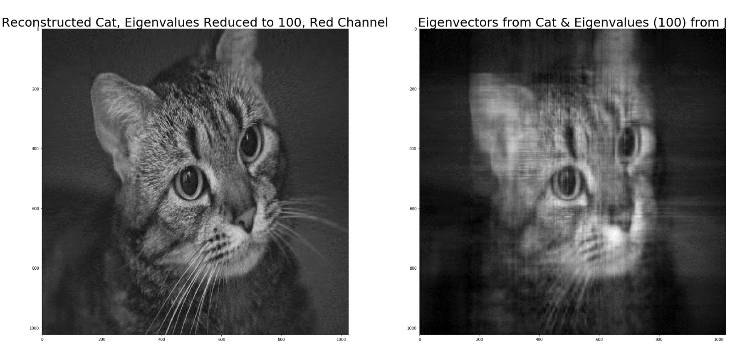
SVD – Mixing Eigenvectors and Eigenvalues
Eigenvectors from Cat and Eigenvalues (reduced to 100) from J
Recombined through SVD = U ∑ V^{T}
Eigenvalues are affecting the luminance (lights and darks) values of the image
U & V^{T}
∑

Slide 12
Links
My GitHub Page:
https://github.com/Johnstul
https://github.com/Johnstul/QR-Decomposition-Images
https://github.com/Johnstul/SVD-Image-Processing
Jstulich07@gmail.com
Jupyter Online Notebooks:
https://jupyter.org/try

Slide 13



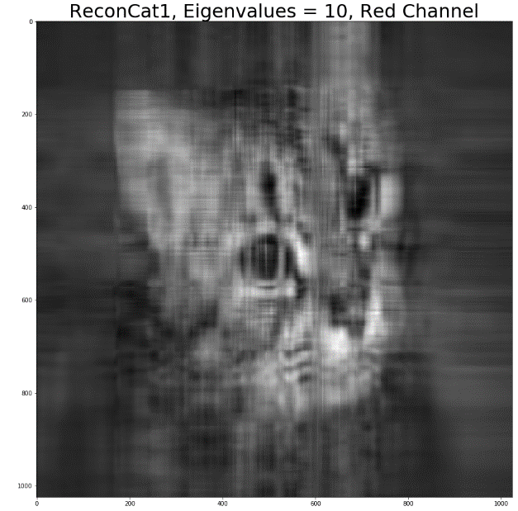
Thanks

